Slide 1
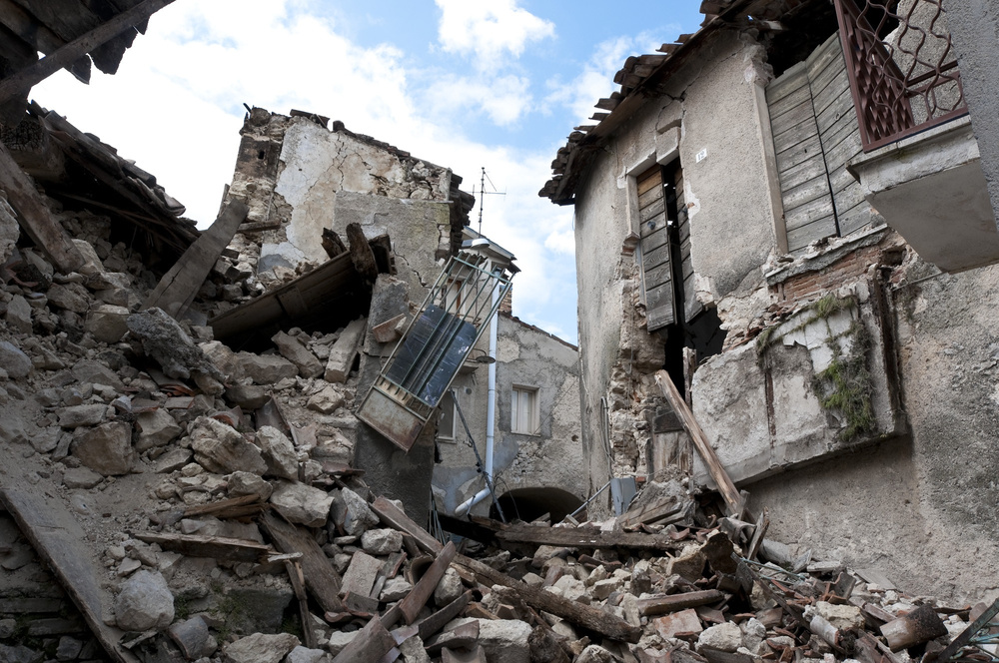

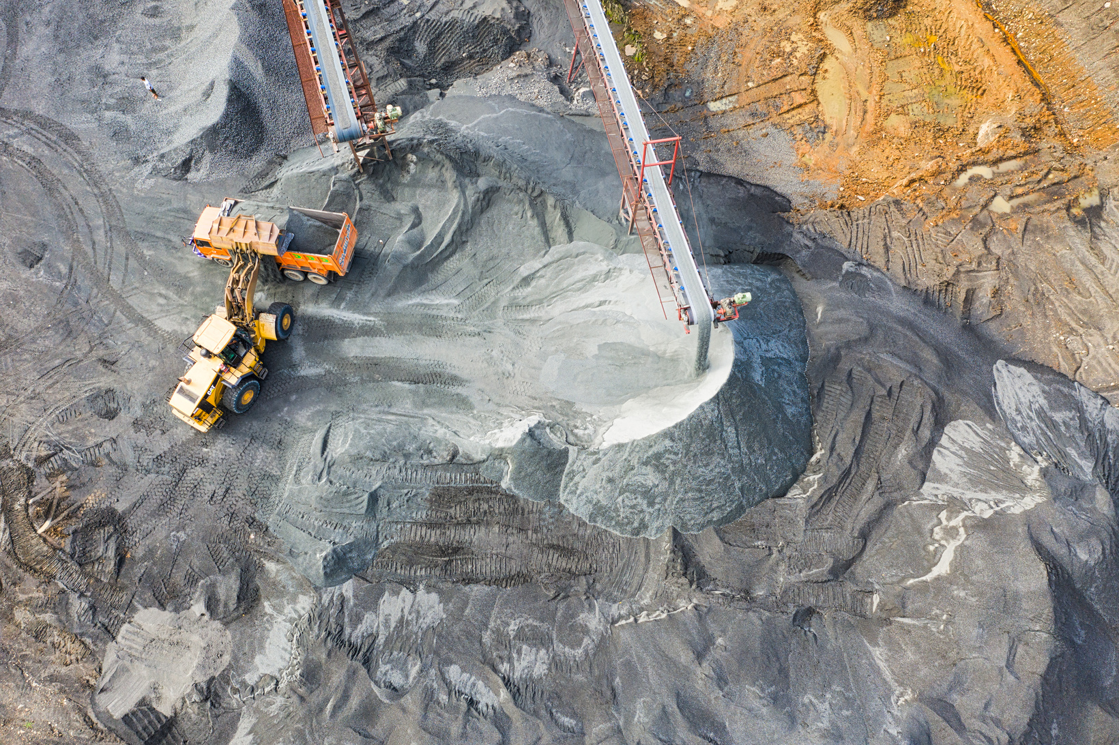
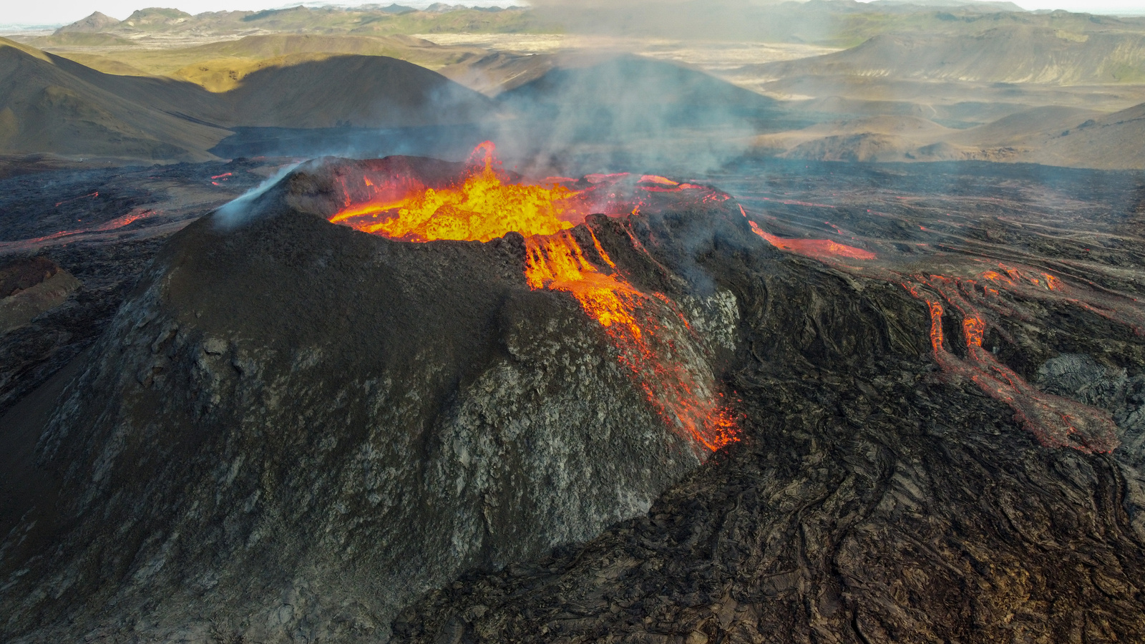
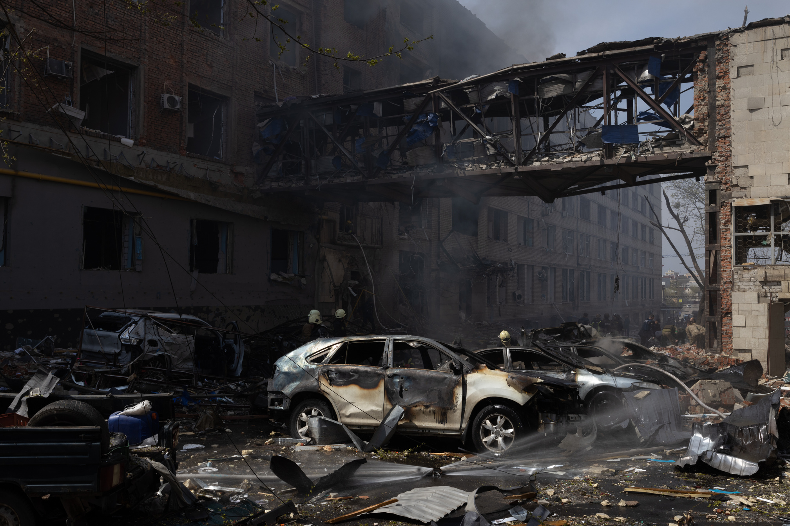

ANALYSIS OF GLOBAL EARTHQUAKES IN 2023
Sriya
Dhanya M
Dhanya V

Slide 2


TABLE OF CONTENTS
Background Information
Dataset Selection
Research Questions
Data Preprocessing
Exploratory Analysis
Machine Learning
Answering research questions-Summary

Slide 3
PROJECT INTRODUCTION
Earthquakes, as natural phenomena, represent a significant geological hazard that can have devastating effects on human societies and the environment. The study of earthquakes, known as seismology, seeks to understand the underlying causes, patterns, and impacts of seismic activity. In this data analysis project, we delve into earthquake data to uncover insights into the spatial and temporal distribution of seismic events, aiming to contribute to our understanding of earthquake behavior and inform disaster preparedness and mitigation efforts.

Slide 4


DATASET
https://www.kaggle.com/datasets/mustafakeser4/earthquakes-2023-global
Total Features:22
Time
Latitude
Longitude
Magnitude
RMS
Depth etc...

Slide 5


RESEARCH QUESTIONS
1•WHICH FEATURES ARE THE BEST ONES TO DETERMINE ANY SEISMIC ACTIVITY?
3•IS THERE A RELATIONSHIP BETWEEN THE TYPE OF SEISMIC ACTIVITY, MAGNITUDE AND DEPTH?
2•WHICH REGIONS WITNESSED THE MOST EARTHQUAKE ACTIVITY?
4. ARE CERTAIN MONTHS MORE PRONE TO EARTHQUAKES?

Slide 6


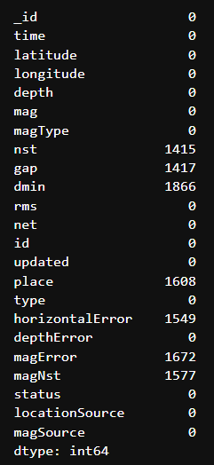
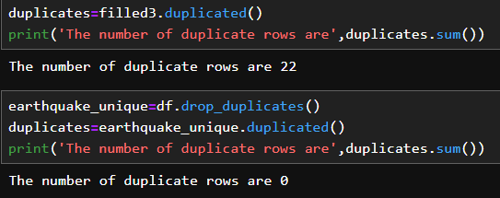
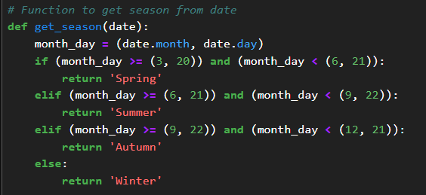
DATA CLEANING AND PREPROCESSING
Missing values are replaced with 0s and mean values as needed
Duplicate rows are removed
Extracting the seasons column using the Date/time column t

Slide 7
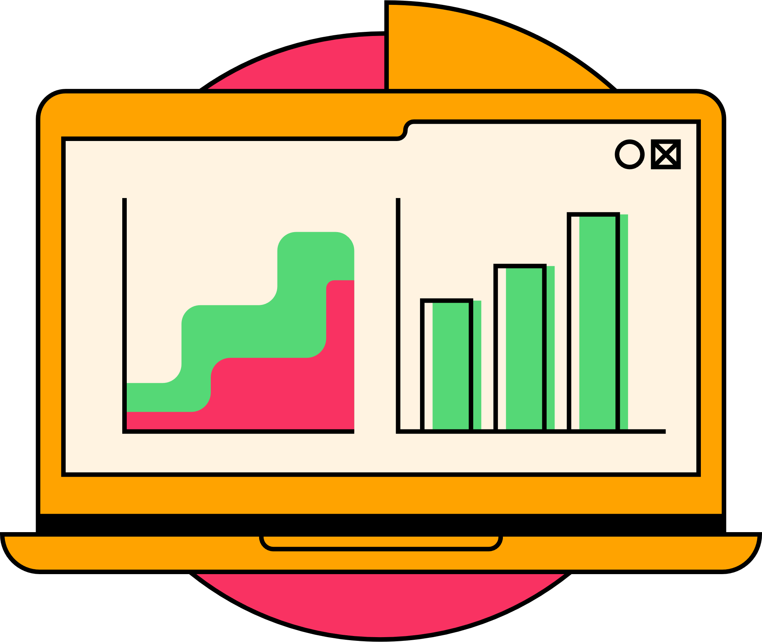


EXPLORATORY DATA ANALYSIS

Slide 8
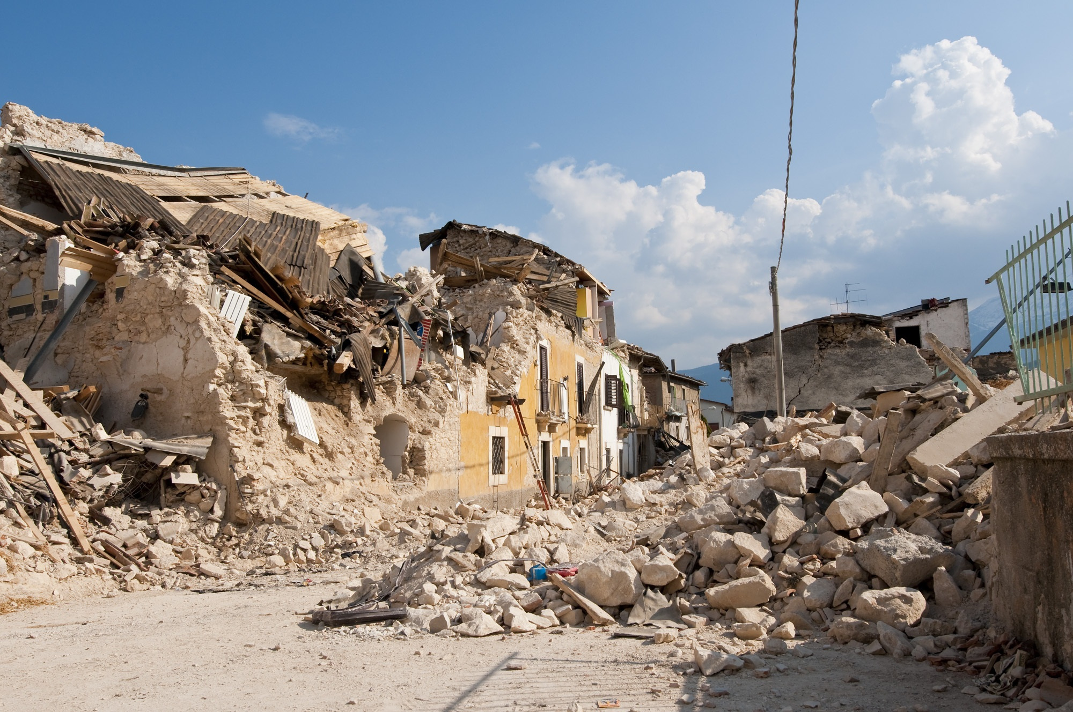

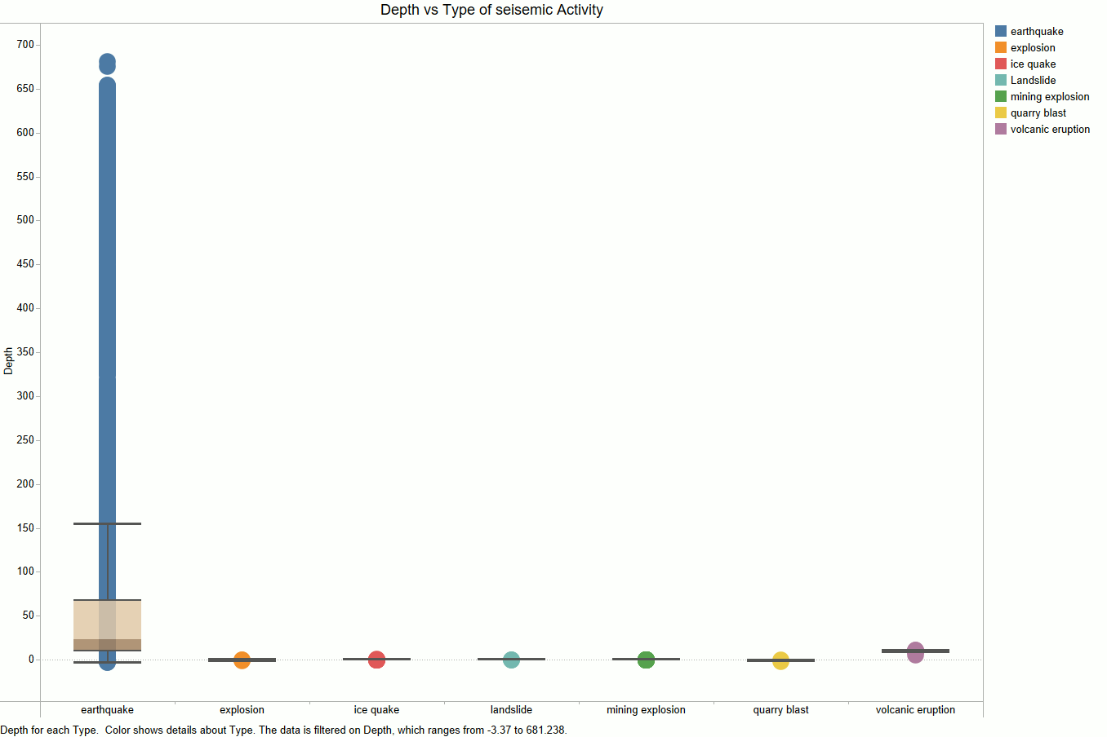
Analysis-1
Depth is a crucial feature that will be examined later. The box plot from Tableau illustrates the depth of each seismic activity.

Slide 9
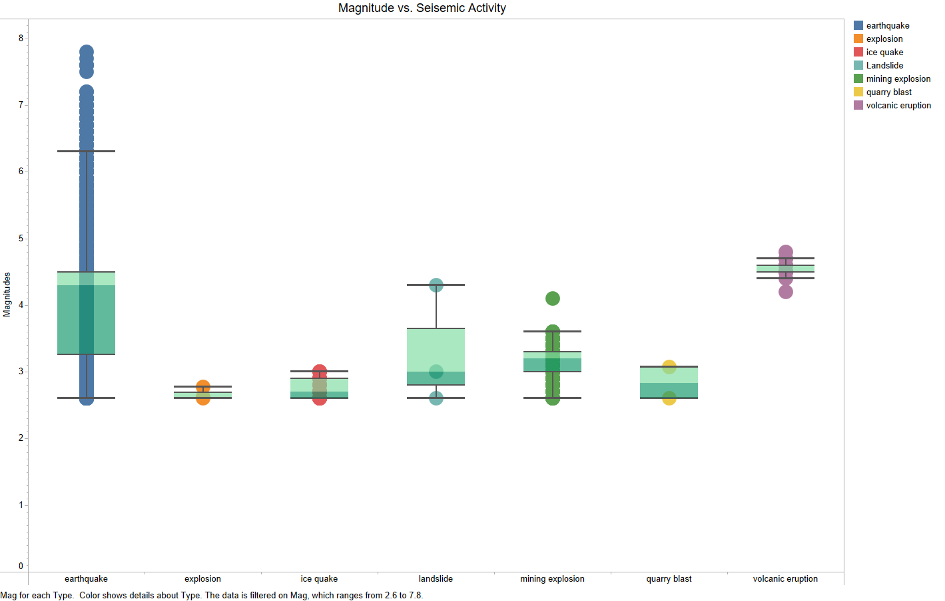

Analysis-2
The magnitude can describe the destruction caused by seisemic activity.

Slide 10
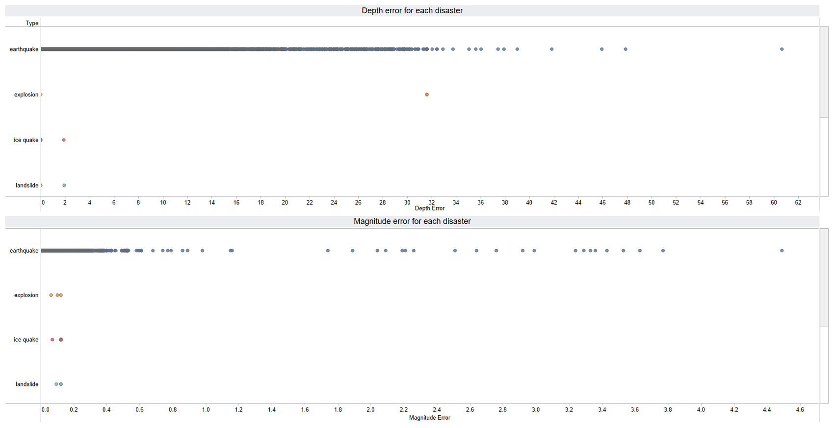
Analysis-3
Depth error is the measure of error when determining the depth of seismic activity. Similarly, there is a magnitude error to consider.

Slide 11

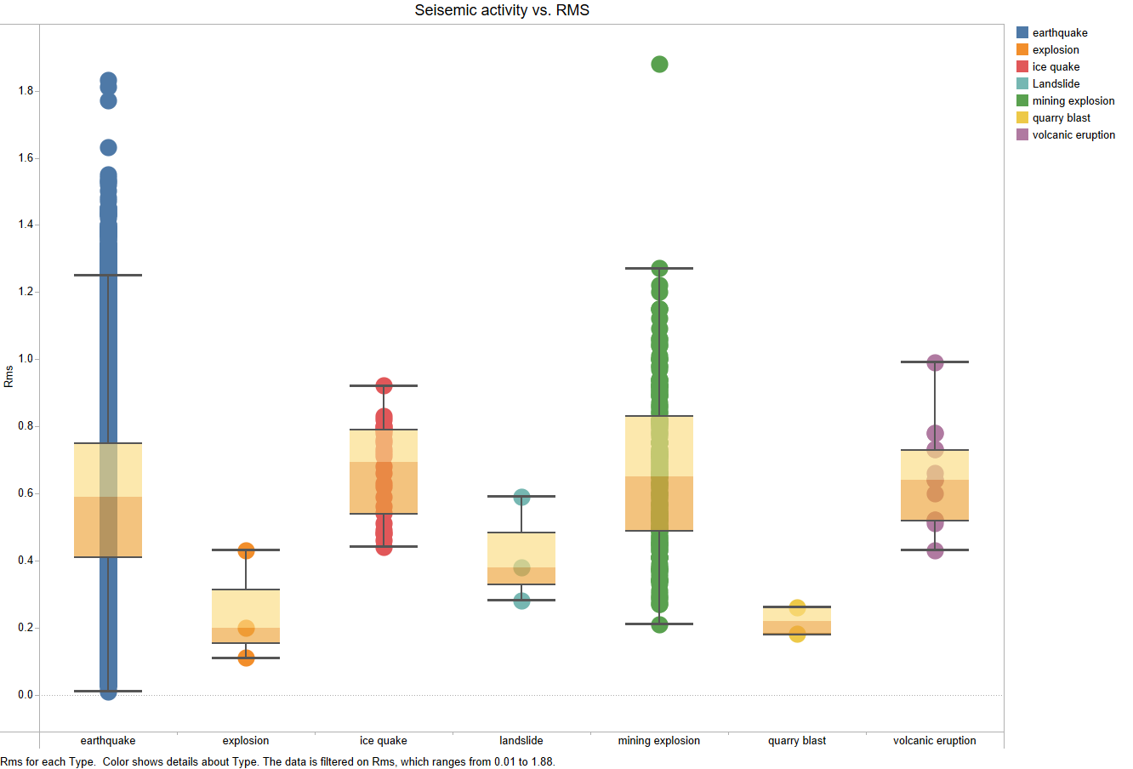
Analysis-4
RMS is like a seismic report card, showing off the earthquake's power and how much it made the ground do the shake in a specific spot.

Slide 12
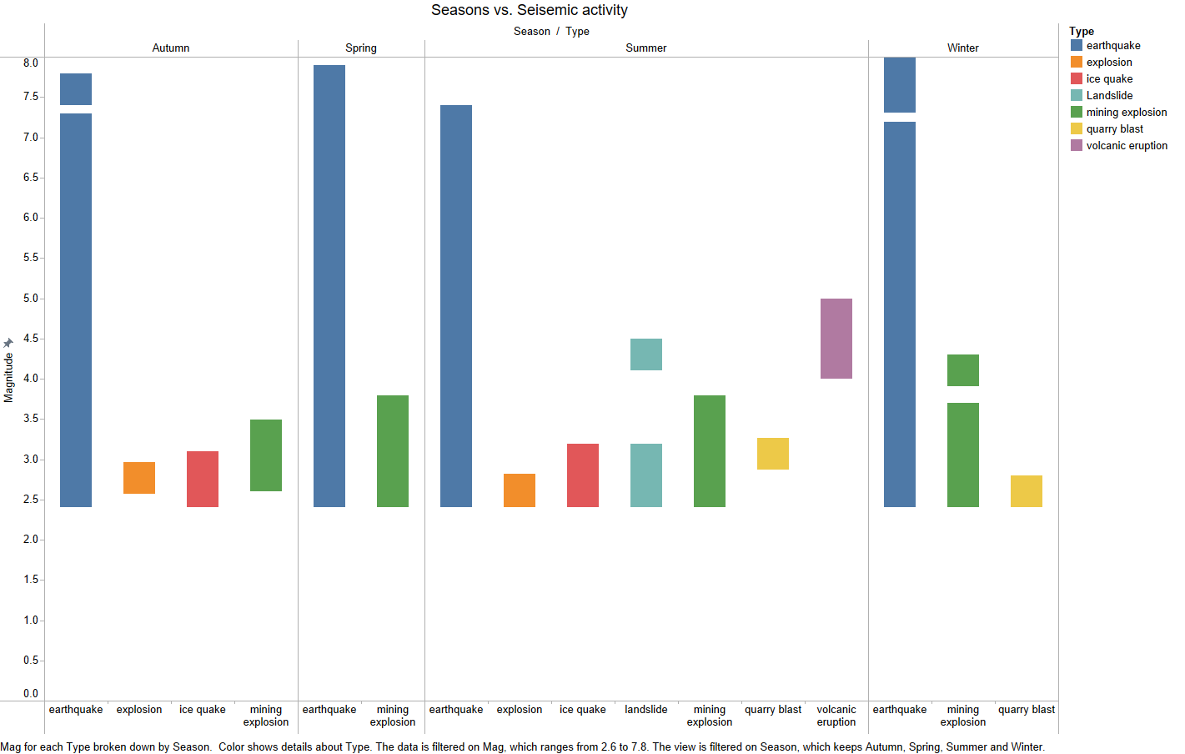
Analysis-5
We can determine the season with the highest number of seismic activities and identify their types from the extracted data.

Slide 13
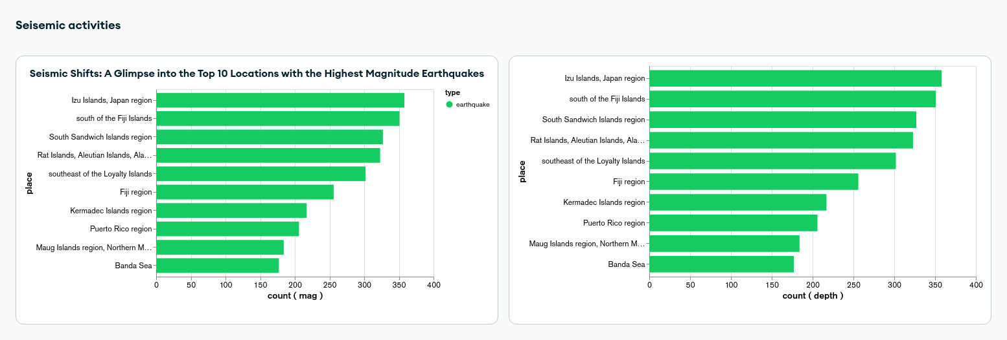
Analysis-6
An interactive chart displaying the top 10 locations most impacted by seismic activity with the highest magnitudes and depths.

Slide 14
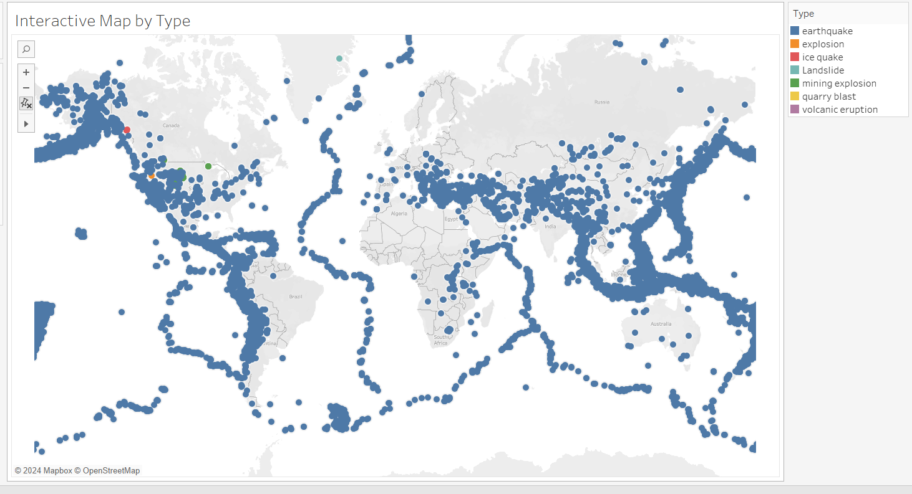
Through this map, we can say that most common activity is earthquakes. Remaining seismic activities are observed in North America areas.
Analysis-7

Slide 15
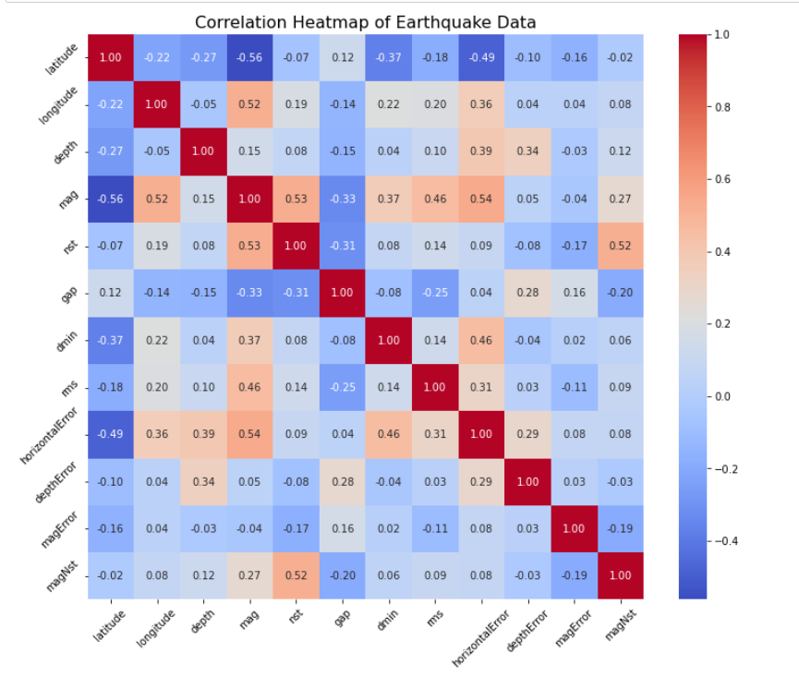
CORRELATION
Correlation analysis in earthquake data involves examining relationships between attributes like magnitude, depth, and occurrence frequency. Positive correlations may indicate that larger earthquakes tend to occur at greater depths or in clustered spatial patterns, potentially associated with geological features.
01 - MAGNITUDE
02 - HORIZONTAL ERROR
03 - LATITUDE

Slide 16

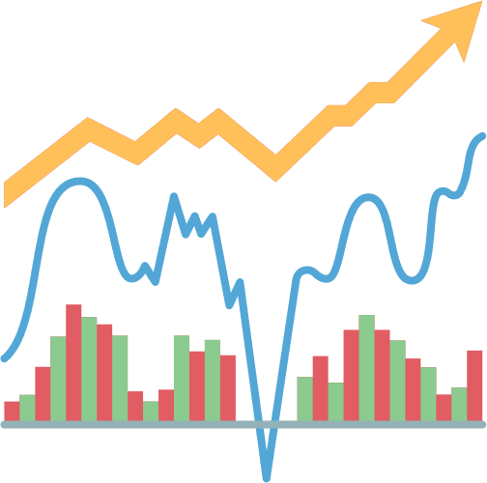

MACHINE LEARNING
ALGORITHMS

Slide 17

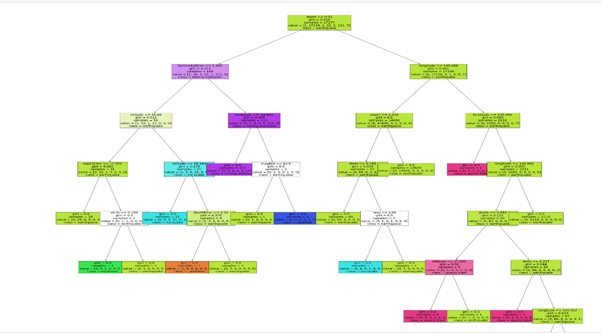
DECISION TREE
•Decision trees provided information about which features (e.g., magnitude, depth, location) are most important in predicting certain outcomes This can help prioritize factors for further investigation or mitigation efforts.

Slide 18
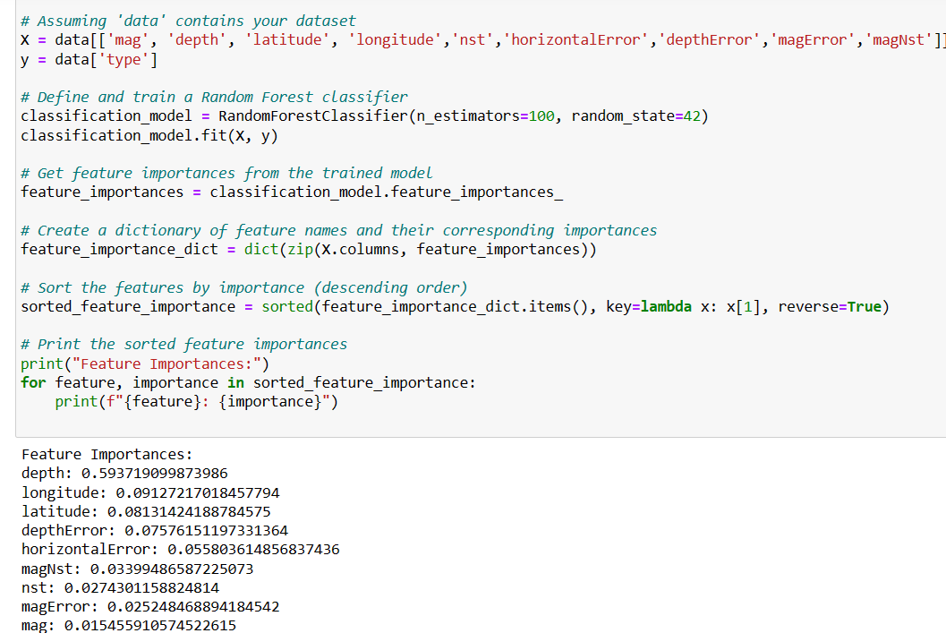
RANDOM FOREST
Random Forest algorithm is employed to analyze earthquake data, extracting important features for seismic activity prediction. Through training, the algorithm identifies the significance of each feature by assessing their contribution to predicting earthquake characteristics like magnitude or frequency. This allows for the prioritization of influential factors, aiding in better understanding seismic behavior and informing mitigation strategies

Slide 19
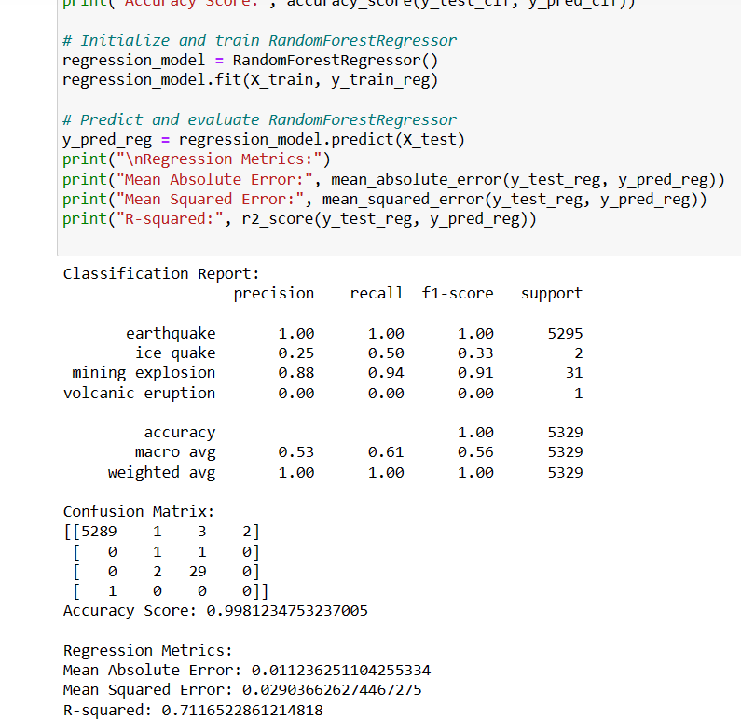
REGRESSION
In regression analysis for earthquake data, utilizing magnitude and depth as predictor variables, the objective is to predict the earthquake type (e.g., tectonic or volcanic). Through model training and evaluation, the regression algorithm learns the relationship between magnitude, depth, and earthquake type, aiding in understanding seismic activity characteristics and facilitating predictive insights for disaster preparedness and mitigation efforts.

Slide 20
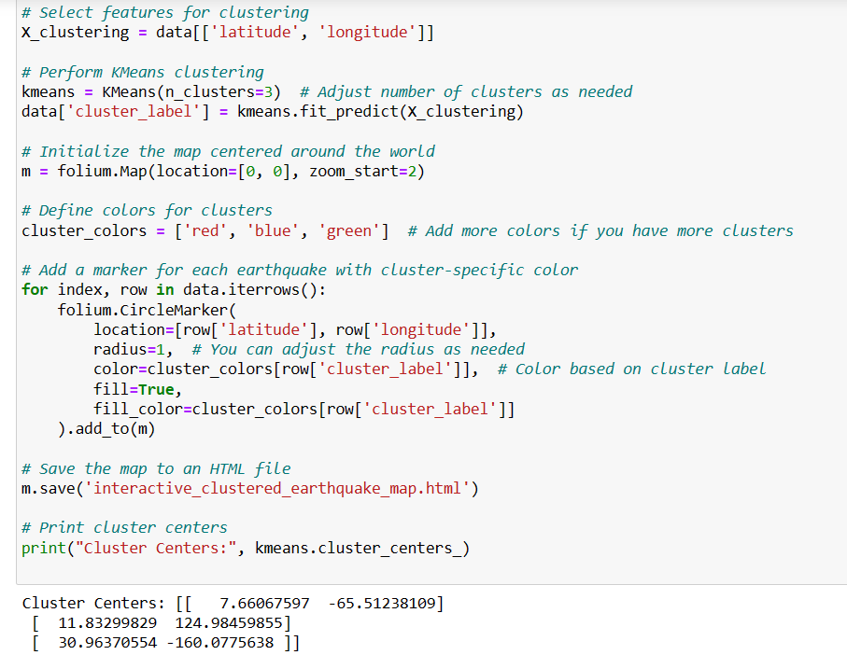
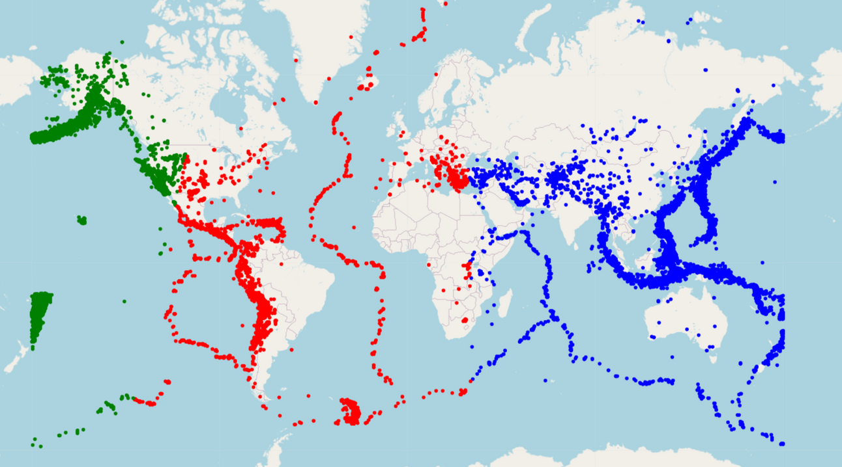
KMEANS CLUSTERING
K-means clustering is applied to earthquake data to identify spatial patterns and hotspots of seismic activity. By grouping earthquakes based on their geographic coordinates, it helps detect regions with high concentrations of seismic events, aiding in the assessment of seismic risk and the prioritization of mitigation efforts. This spatial analysis approach enables the identification of areas prone to earthquakes, facilitating targeted interventions for disaster preparedness and response.

Slide 21
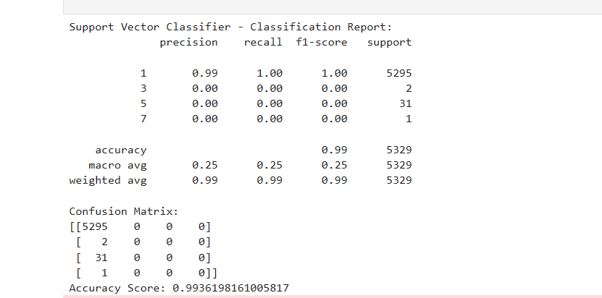

SUPPORT VECTOR MACHINE
Support Vector Classifier (SVC) demonstrates impressive accuracy, achieving approximately 99.36%. However, it faces challenges with minority classes, such as classes representing less frequent magnitudes or locations. These classes exhibit precision, recall, and F1-scores of zero, indicating the classifier's struggle to correctly identify instances in these categories

Slide 22
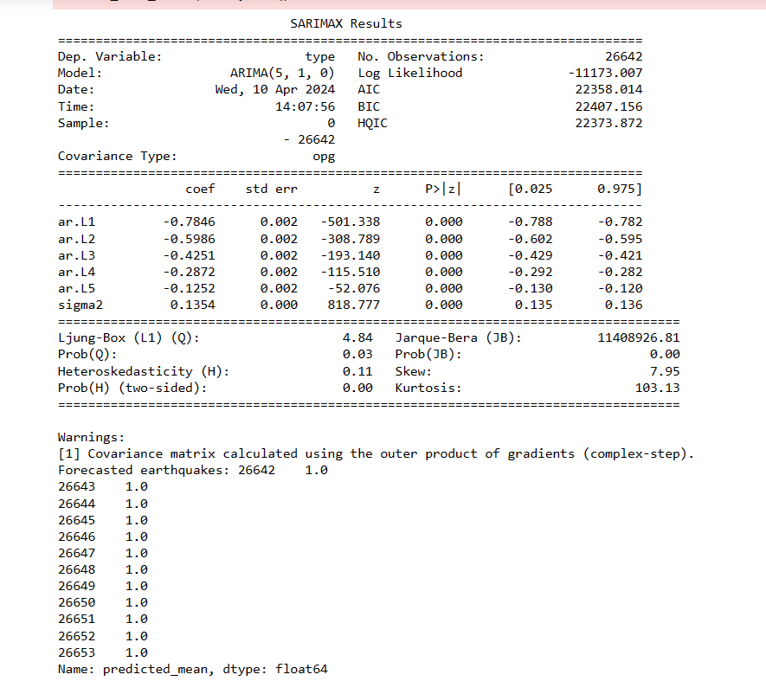
TIME SERIES ANALYSIS
In time series analysis for earthquake data, SARIMAX (Seasonal AutoRegressive Integrated Moving Average with eXogenous factors) models are employed to forecast seismic activity over time. By considering seasonal patterns, trends, and external variables like earthquake magnitude or depth, SARIMAX models provide accurate predictions of future seismic events. This approach aids in understanding temporal dynamics of earthquakes and enhances decision-making for disaster preparedness and risk mitigation strategies.

Slide 23




SUMMARY
WHICH FEATURES ARE THE BEST ONES TO DETERMINE SEISMIC ACTIVITY?
+24K
From Random forest, Decision tress classification models; magnitude, depth and location are important features for performing analysis on the earthquake data
+10K
WHICH REGIONS WITNESSED THE MOST EARTHQUAKE ACTIVITY?
Performing k-means clustering, we found out the most earthquake prone areas are in pacific ocean, countries like japan,indonesia and south america etc.
+50K
IS THERE A RELATIONSHIP BETWEEN THE TYPE OF SEISMIC ACTIVITY, MAGNITUDE AND DEPTH?
By performing the regression model, we found that there are relationship between magnitude, depth, seismic activity with metrics values
ARE CERTAIN MONTHS MORE PRONE TO EARTHQUAKES?
From time series analysis, it was found that earthquakes are most prone on the months of winter and spring.

Slide 24
Conclusion
Given that the data is from 2023, descriptive models provide valuable insights into the data compared to predictive models. The descriptive characteristics of decision trees and Random Forest indicate that depth, rather than magnitude, can offer a better explanation of seismic activity. Additionally, earthquakes are the most common disasters worldwide. Island chains like Japan, Indonesia, and the Philippines are located along major tectonic plate boundaries and experience frequent seismic activity.

Slide 25


Project Group Contribution
MACHINE LEARNING ANALYSIS
DATA PREPROCESSING
•Identify and handle missing values
•Standardize formats
•Filter outlier data points
•In-depth Analysis
Worked: Dhanya V, Sriya
•Clustering
• random forest regression model
• Decision tree classifier
Worked: Dhanya M, Dhanya V
REPORT
•Compiling final report
2
4
6
1
3
5
DATA COLLECTION
EXPLORATORY ANALYSIS
INSIGHTS
•Obtain and clean dataset
•Source dataset
Worked: Dhanya V, Sriya
•Generate statistical summaries
•Create visualizations by location and date/time attributes
•Surface early insights into relationships
•Identify most earthquake prone countries/regions
Worked: Dhanya M , Sriya
•Brainstorming additional analyses
•Reviewing results as a team

Slide 26
REFERENCES
R, S. E. (2024, April 19). Understand random forest algorithms with examples (Updated 2024). Analytics Vidhya. https://www.analyticsvidhya.com/blog/2021/06/understanding-random-forest/
Patil, P. (2022, May 30). What is Exploratory Data Analysis? - Towards Data Science. Medium. https://towardsdatascience.com/exploratory-data-analysis-8fc1cb20fd15
GeeksforGeeks. (2023a, May 6). Data preprocessing in data mining. GeeksforGeeks. https://www.geeksforgeeks.org/data-preprocessing-in-data-mining/

Slide 27

THANK YOU

